Slide 1

Work System Design Project
IM29202
Sanskar Agrawal 20IM30019
Sneha Kumari 20IM30020
Sridhara Manideep 20IM30021
Suvigya Saxena 20IM30022
Vedant Tarole 20IM30023
Trisha Sarwade 20IM30024
Udit Jain 20IM30025
Sanil Upasani 20IM30026
-By Group 4

Slide 2

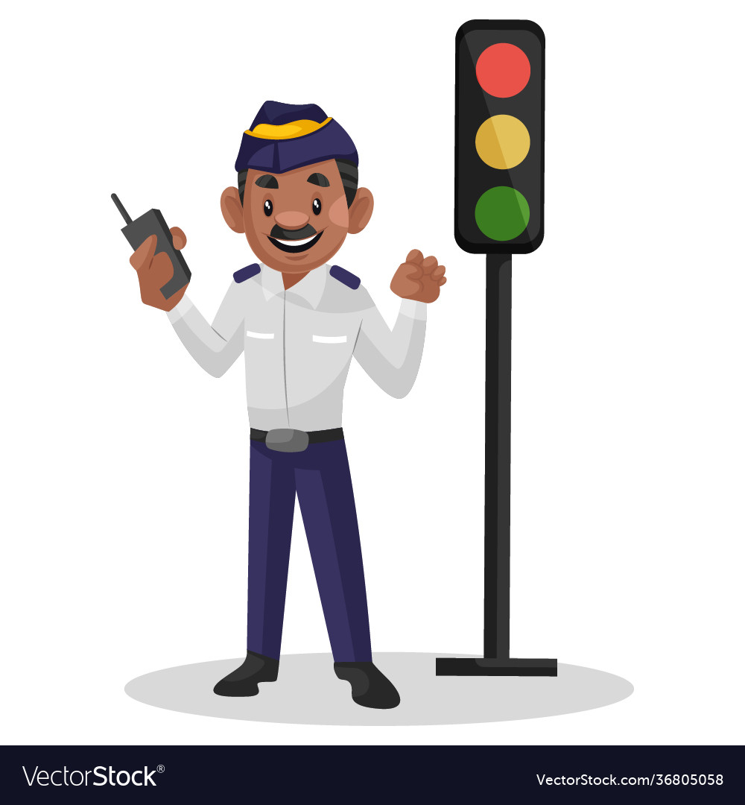
Defense and Security
Traffic Police Work System

Slide 3
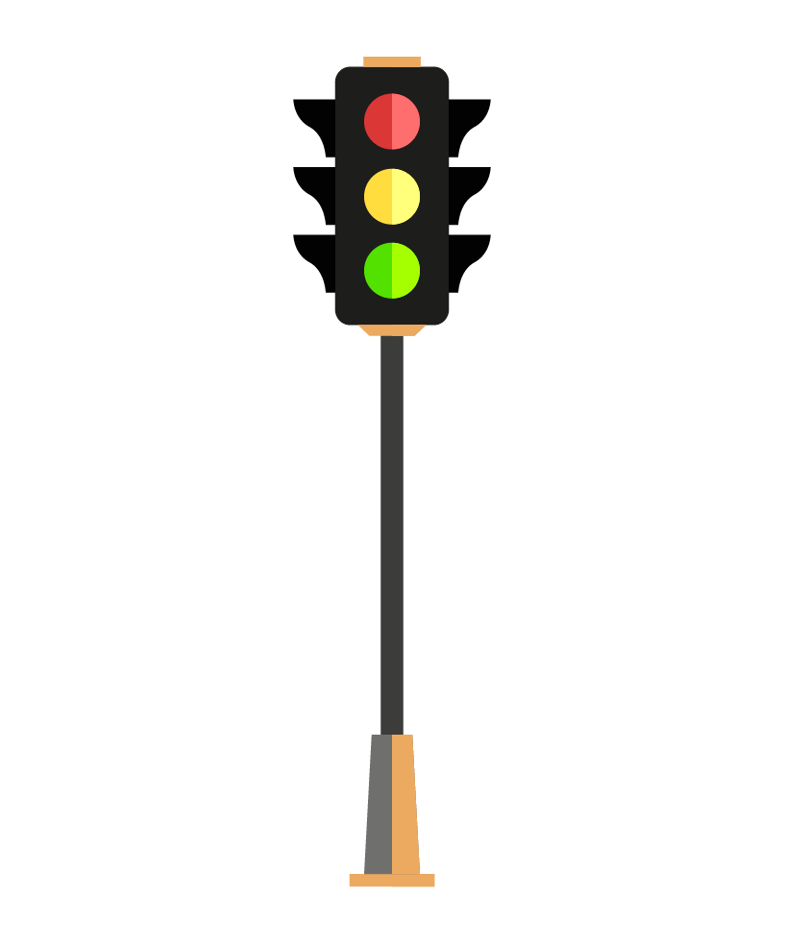
We are starting our project by designing the Control Room!
Through this, we attempt to address one of the most significant drawbacks i.e. reducing the exposure of Traffic Police.
This setup will help in maintaining their health and consequently improve their efficiency and alertness at working hours to a great extent.
The Traffic Police Control Room

Slide 4
OVERVIEW
Design of the control room office.
(shape & structure)
Internal features of control room which ensures comfort and effectiveness of the traffic police.
Functions of the Control Room.
Video presentation of the control room.

Slide 5
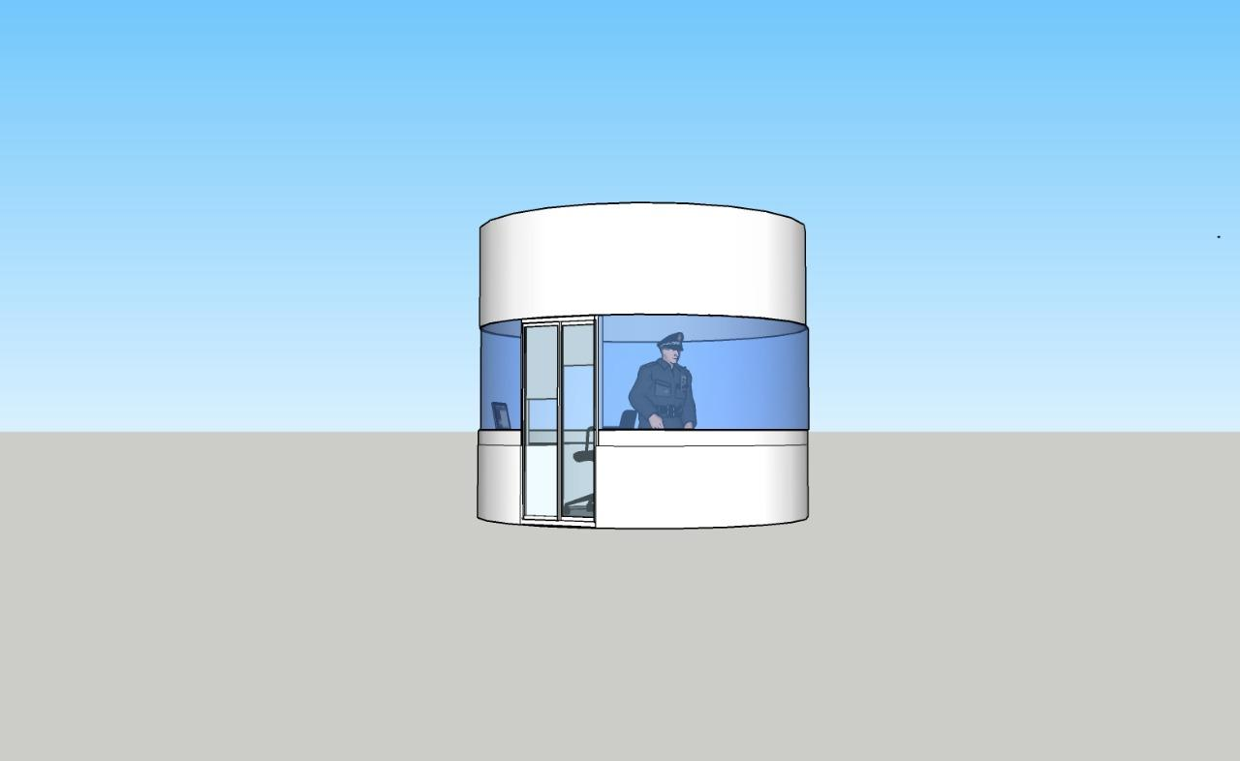
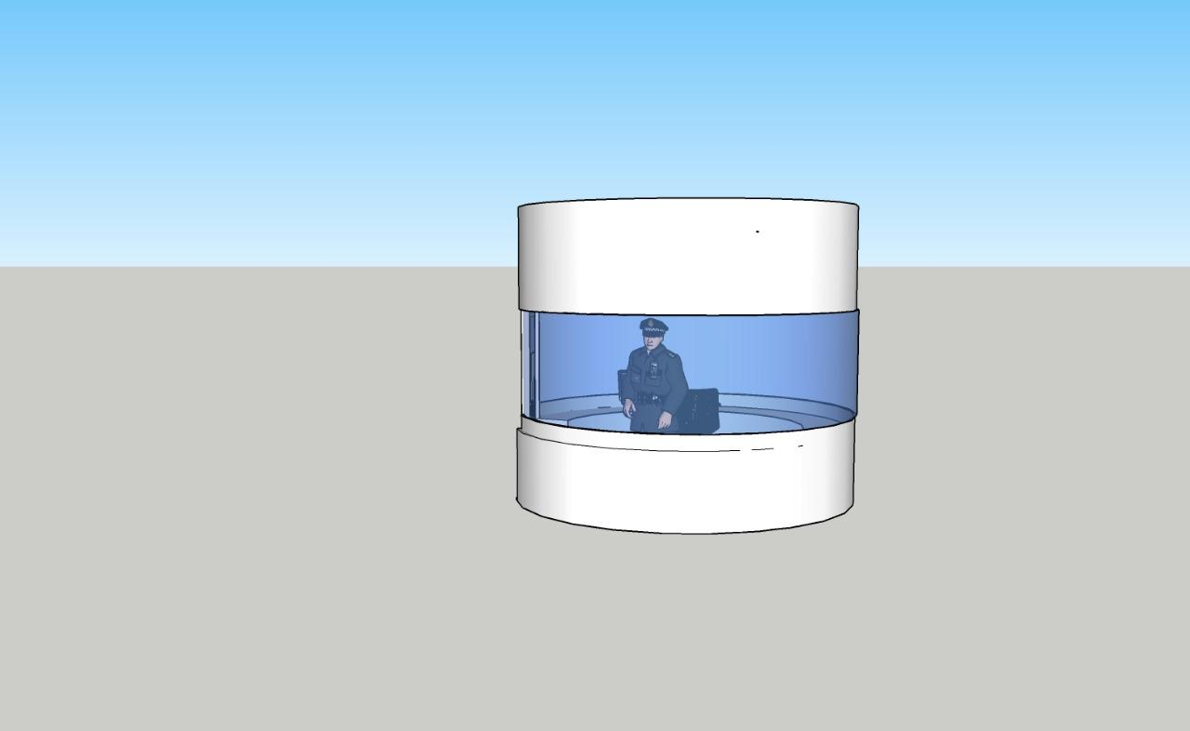
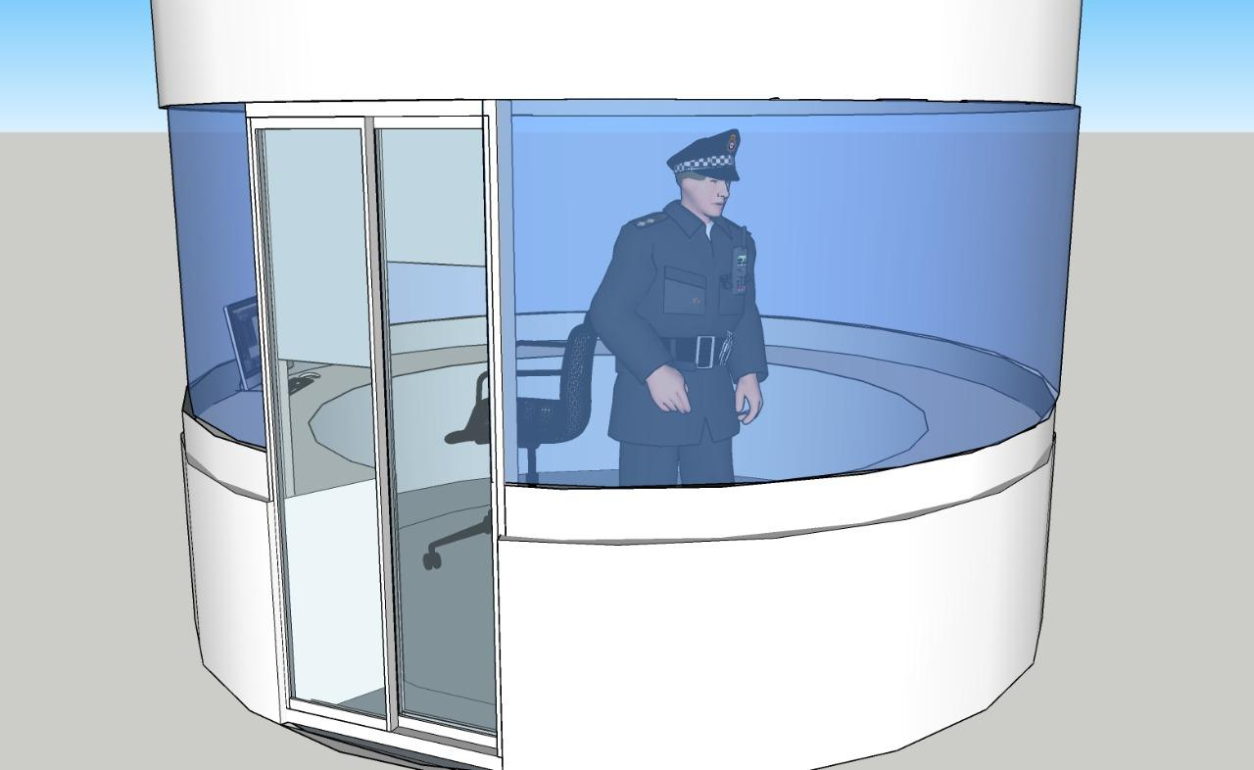
Shape & Structure of the Control Room

Slide 6


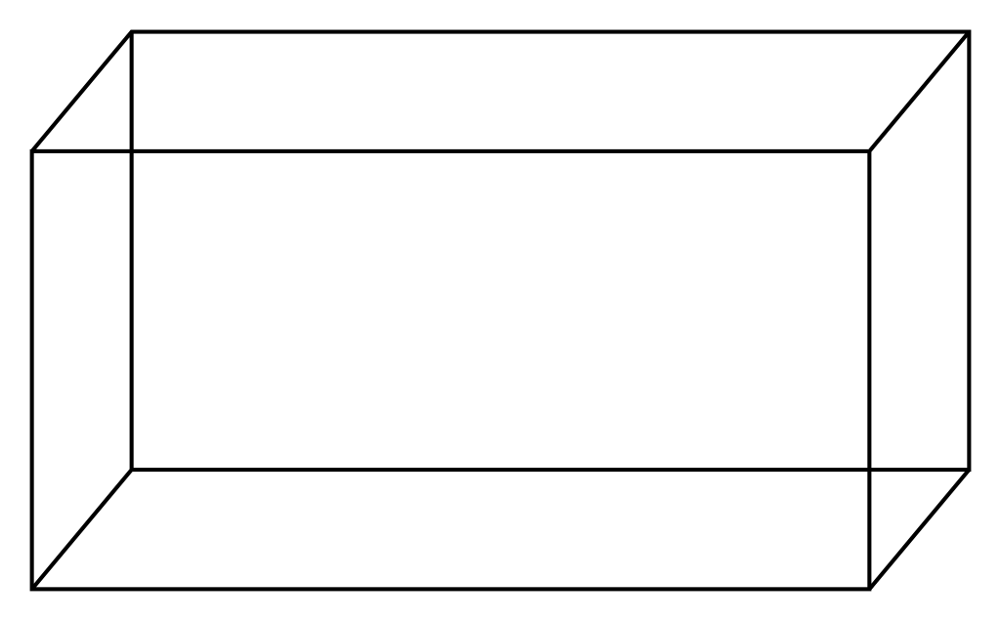
Why cylindrical room?
A rectangular base will make it inefficient to use all the space inside.
Being of a higher surface area, it will require more cost for labour and installation.
A circular base will help save space in the centre of the road.
Lesser surface area will also allow wind to flow smoothly outside the room.

Slide 7
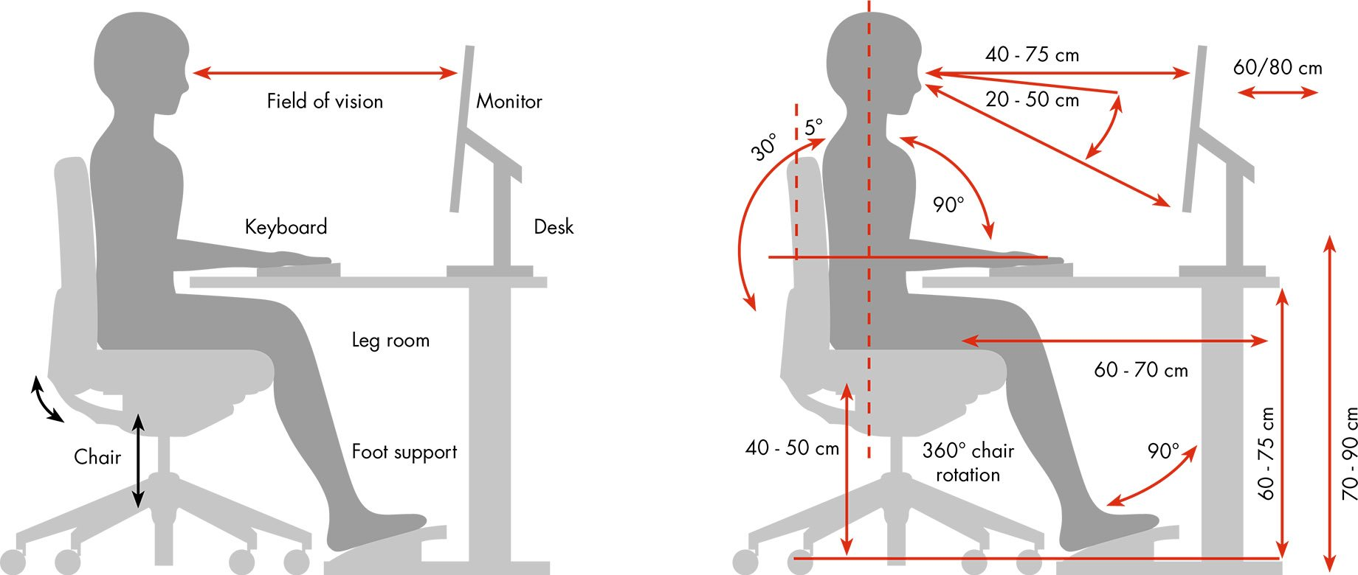
An Ergonomics Chair
Its extremely important to have a comfortable environment in order to work efficiently.
Moving a step further to achieve this, we are designing a chair that serves this purpose very efficiently.

Slide 8

MULTIPURPOSE WINDOW GLASS
Prolonged exposure to noise pollution can adversely affect hearing, cause stress, fatigue and disturbed sleep. A practical solution to the problem of increasing levels of outside noise- be it the blaring of car horns, the racket from construction sites, accident scenarios, is to opt for soundproof glass or acoustic glass for windows and doors :
A laminated glass manufactured by joining two layers of glass with an interlayer of Polyvinyl Butyral or PVB in between them.
Noise Reduction : It creates a near-impregnable barrier between the external noise and your ear and blocks external noise by up to 90%.
Enhanced Safety : As the soundproof glass consists of an inner PVB interlayer, it does not break easily. If in a rare situation, this glass type does end up breaking, the glass pieces remain stuck to the PVB interlayer and don’t shatter, thereby giving the glass a spider-web-like appearance. As this glass does not shatter and fall out, it reduces the chances of any incurring injuries from the jagged glass shards.
Heightened Security : It can be constructed with multiple glass panes in different thickness, which makes it even sturdier.
Better Comfort : To ensure an ideal temperature inside, a Low-E coating,can insulate the interiors optimally i.e.during the summer, it keeps the interiors cool by reflecting the sun’s heat away while during winters, these glass windows prevent heat from escaping through them. As a result of this, the need for artificial cooling or heating systems reduces, making it quite an energy-efficient.
UV-Protection : These laminated glasses block harmful UV & IR rays and also protects from solar glare.

Slide 9

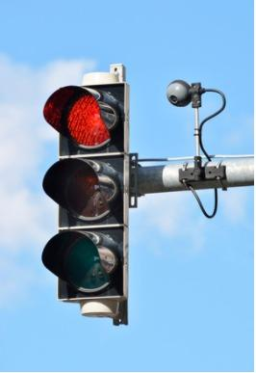
We will be measuring the traffic density through cameras fitted on the outer body of control room which will be utilised in the synchronisation of metallic hands and traffic lights.
Whenever the traffic density will be low ,we will be using the as usual traffic lights while in case of high density, the control room shuts the lights functioning and turns on the metallic hands which will then be operated by the traffic policeman sitting on chair through buttons.
The data that we would be collecting from control room could also be communicated to other checkposts which can be highly useful in trapping criminals,terrorists. In this way our system would be also extending it’s hands towards the concept of security.​
The workload on the policemen would be drastically reduced,hence improving the overall health of individual.​
FUNCTIONS OF THE CONTROL ROOM​

Slide 10

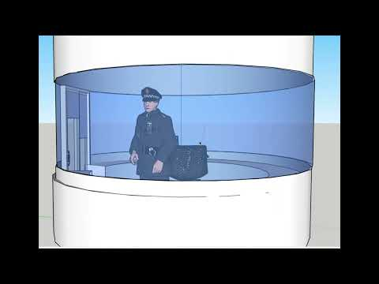

Slide 11

Next week we will discuss the challan redesigned system which is synchronised with our control room facilities along with Integration of external components with control room
Our Next Step…

Slide 12



That’s the transition we want to bring!!

Slide 13


